Slide 1

Smart water meter data analysed to solve water issues
Project No: 1
Members of the Team:
Reg No | Name
CB.EN.U4CSE21302 | Abinesh.T
CB.EN.U4CSE21353 | Sanjanaa Maturi
CB.EN.U4CSE21354 | Sathish.J
CB.EN.U4CSE21357 | Shreeya Asawa

Slide 2
Objective of the Project
Monitor the flow, distribution, and consumption of water.
Improve access to clean and safe water.
Enable real-time or frequent access to water consumption information and billing.
Reduce manual water meter reading.
Improve leak and fraud detection.
Increases data collection accuracy.
To conserve water.

Slide 3
Modules of the Project
Module-1: Register: To ask to the user to enter the details including the serial number the serial number of the smart water meter.
Module-2:
Login: User logging into the website using the given credentials .
Module -3:
Getting data:
getting the smart water meter data from the each meter.
Module-4: Analyzing the data:
Data are fetched from the meter and the data is analyzed based on the residence and the industry and from which the data can be visualized as graph
Module-5: Billing: based on the consumption the price each consumer will billed each month.
Module-6: Report: Based on the analysis of each user data a report can be sent to the user each month so that water conservation can be done.

Slide 4
Implementation
Front End UI Design
Back End DB Design
HTML
CSS
Javascript
Bootstrap
Jquery
React
XML
Python
Node.js
MongoDB

Slide 5
Entities Identified and its attributes
Login – (
Username
Password
Registration_id )
Registration – (
Username
Password
Zone
Name
Phone_no )
Zones – (
Zone_id
Zone )
Project_data –(
Registration_id
Serial_no
Date
Consumption
Type_id
Charge_per_month
Price )
Type- (
Type_id
Type
Price )
Product_buyer_details – (
C_name
Address
Phone_no
Registration_id
Product_id
Serial_no
Zone_id )
Product_details – (
Product_id
Product_name
Price
Serial_no
Type_id )

Slide 6
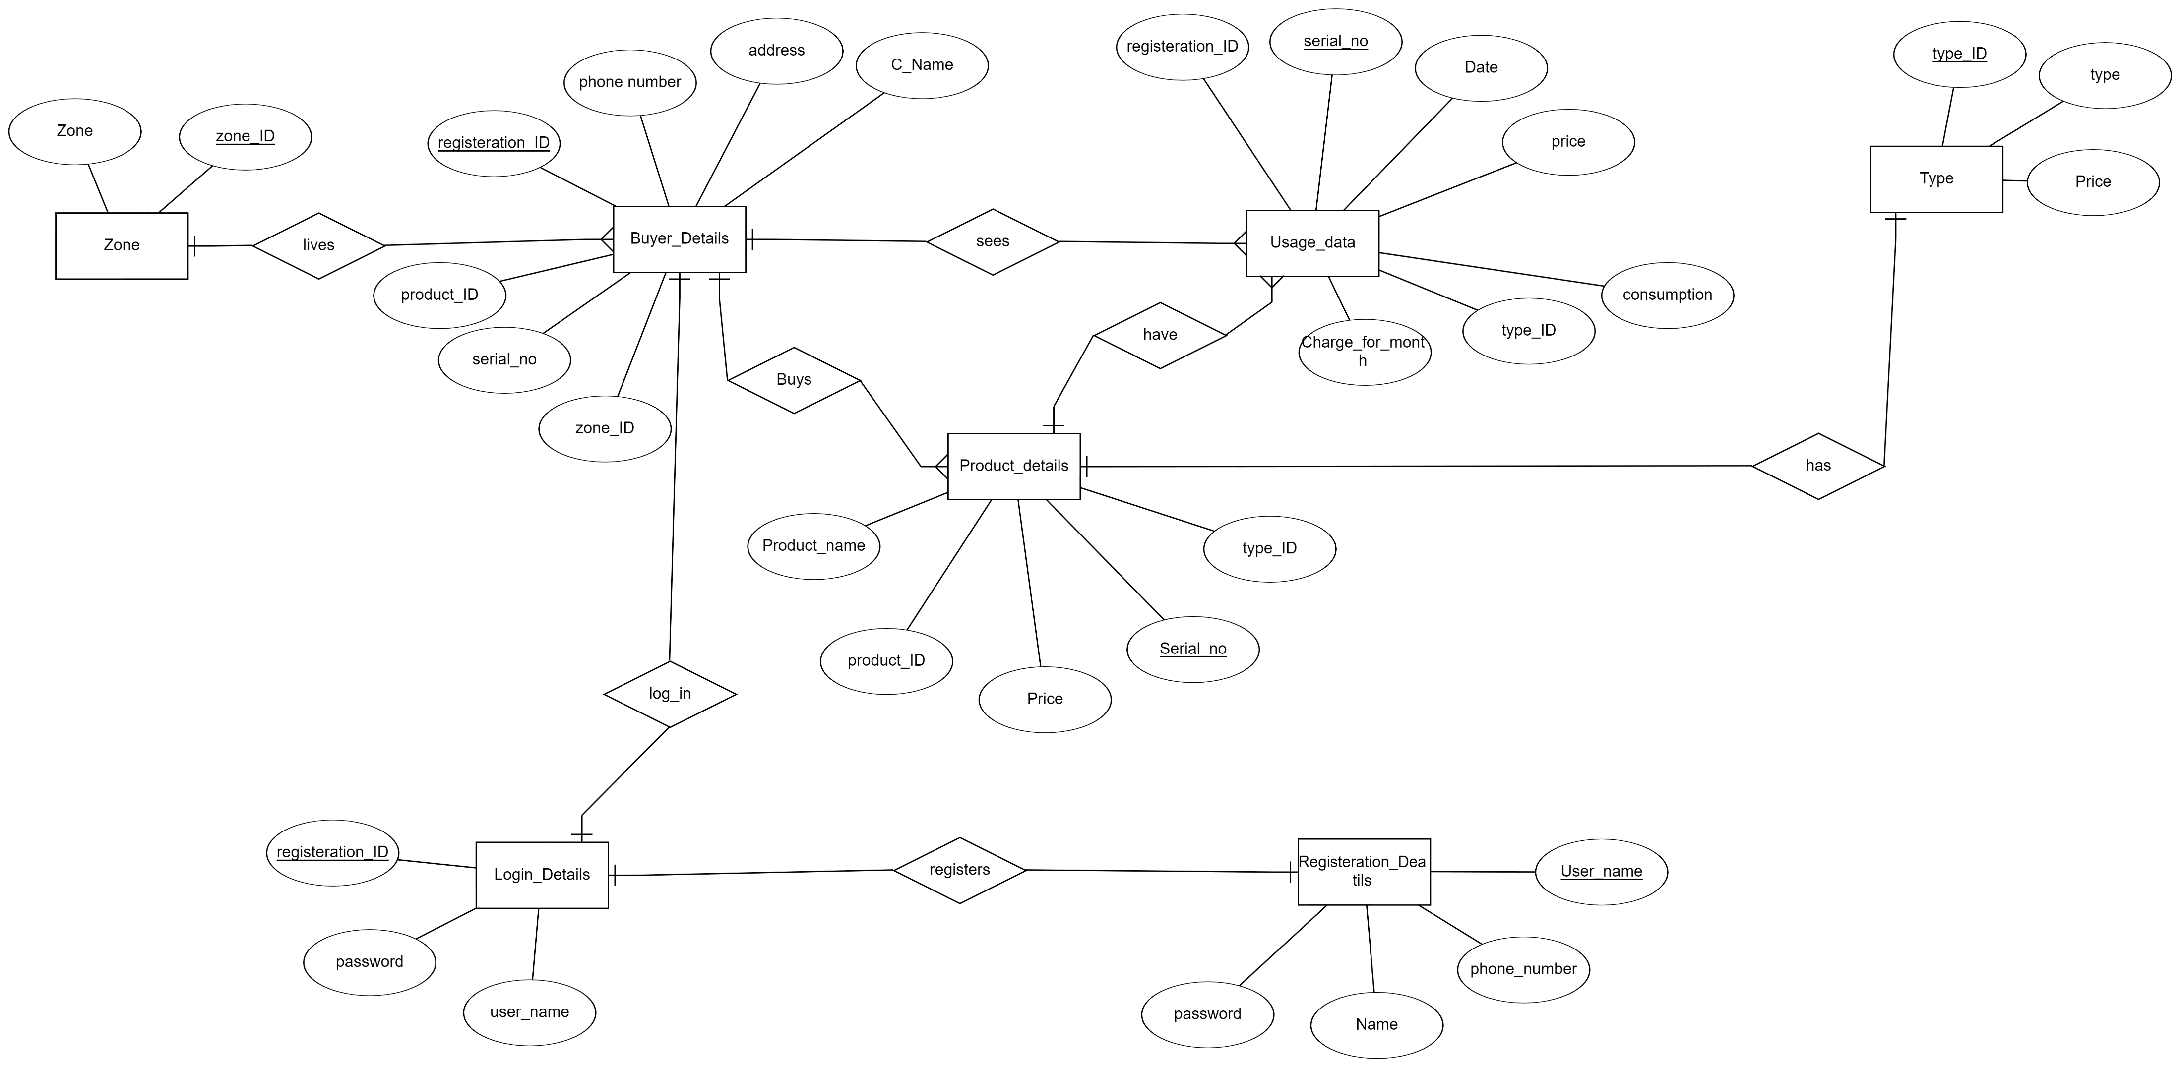
ER Diagram

Slide 7
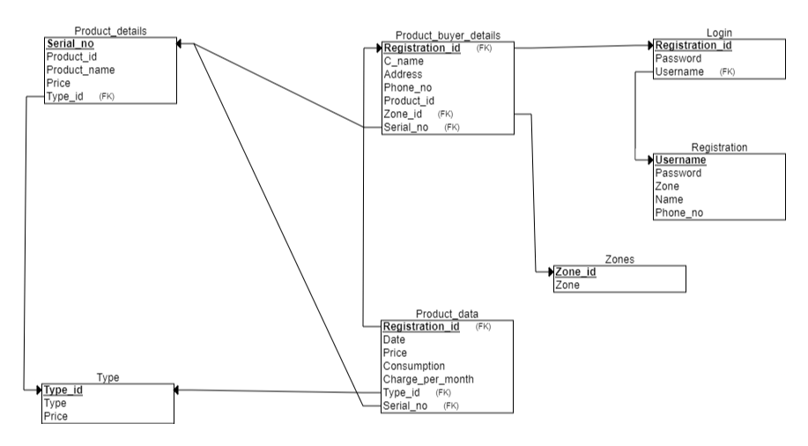
Schema

Slide 8
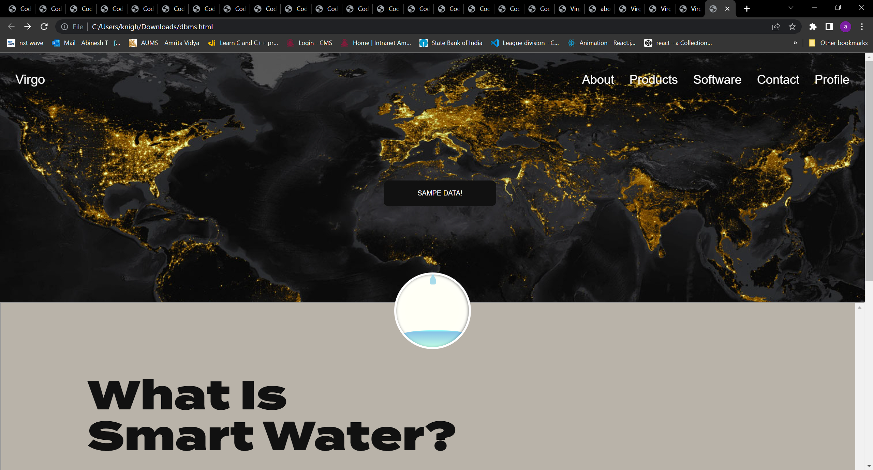
UI DESIGN: PAGE 1

Slide 9
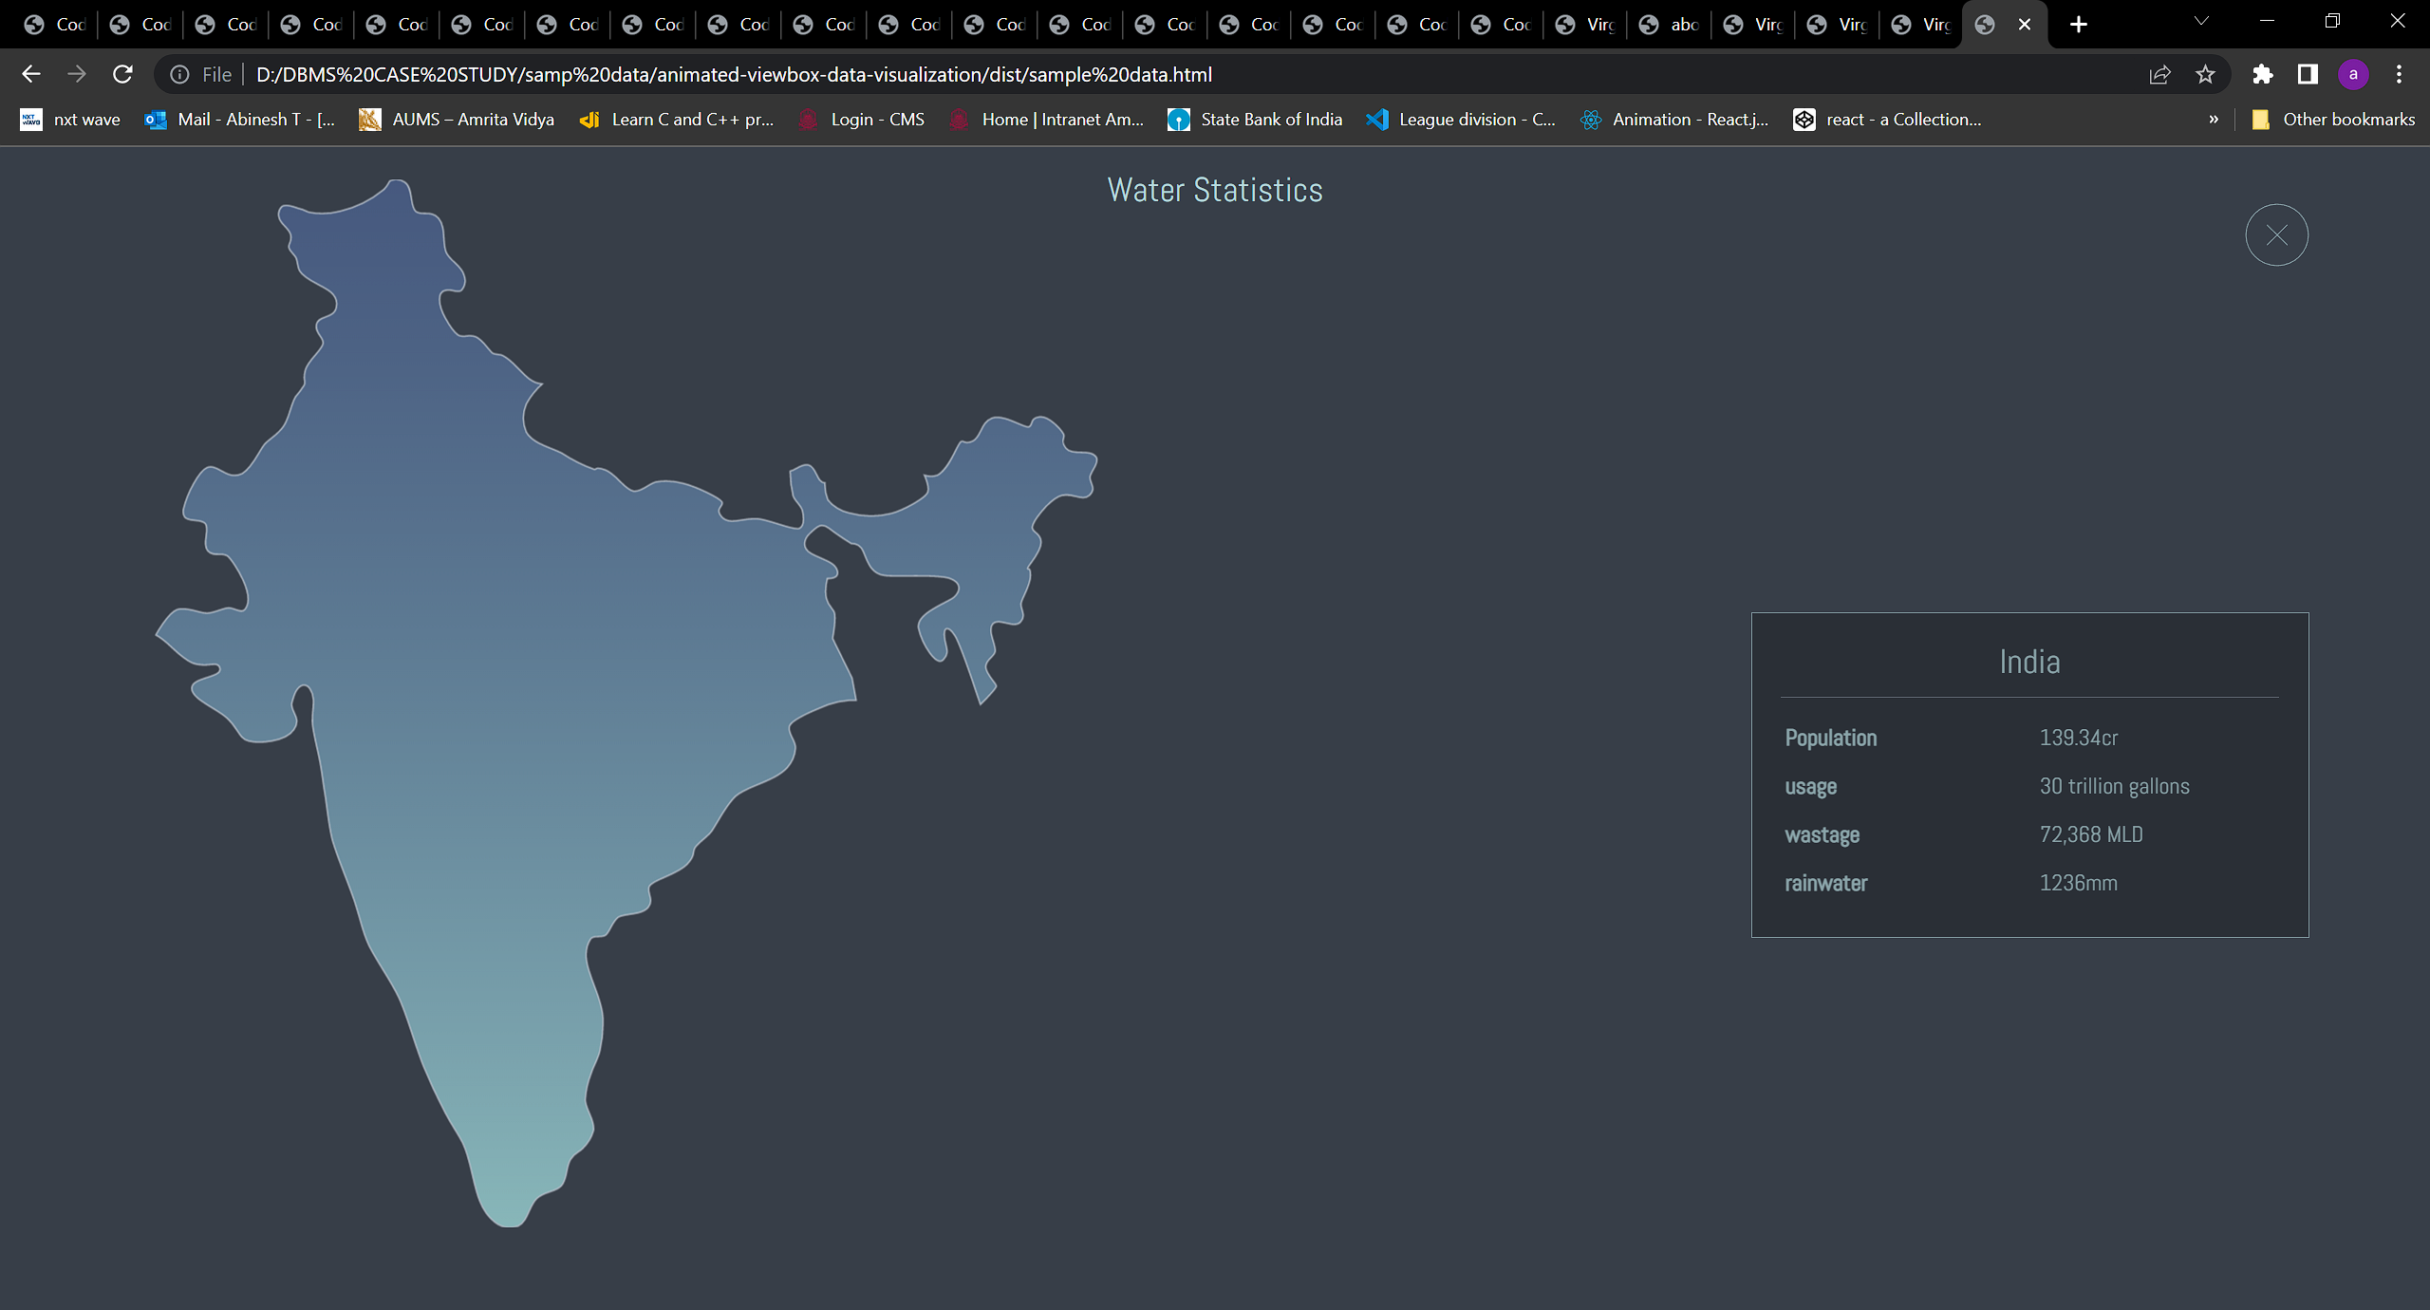
UI DESIGN: PAGE 1

Slide 10


